Slide 1
ACI Session 4: Uninfomed Search Revisited: DFS,BFS,DLS,IDS. UCS, bidirectional search Informed Search: Best First

Slide 2
Search Algorithms
Breadth First Search
Uniform Cost Search
Depth First Search
Depth Limited Search
Iterative deepening Depth First Search
Informed Search
Best First greedy Search

Slide 3
Breadth First Search

Slide 4
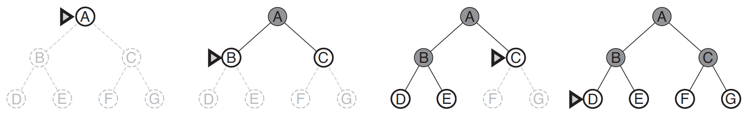
Breadth First Search (BFS)
Initially fringe is 1. A
2. B C goal node: F
3. C D E
4. D E F G
E F G PATH: A- C-F: COST:1+1:2
F G
Generate all nodes at a given depth before proceeding to deeper nodes

Slide 5
Breadth First Search
All nodes at a given depth are expanded first before any nodes at next level
FIFO queue for Frontier
Shallowest (min depth) unexpanded node is chosen for expansion
Instance of general graph-search algorithm
Discards any redundant path by checking with Explored Set and Frontier Set (must have a path shallower which was seen before)
Hence, it always has the shallowest path to every state

Slide 6
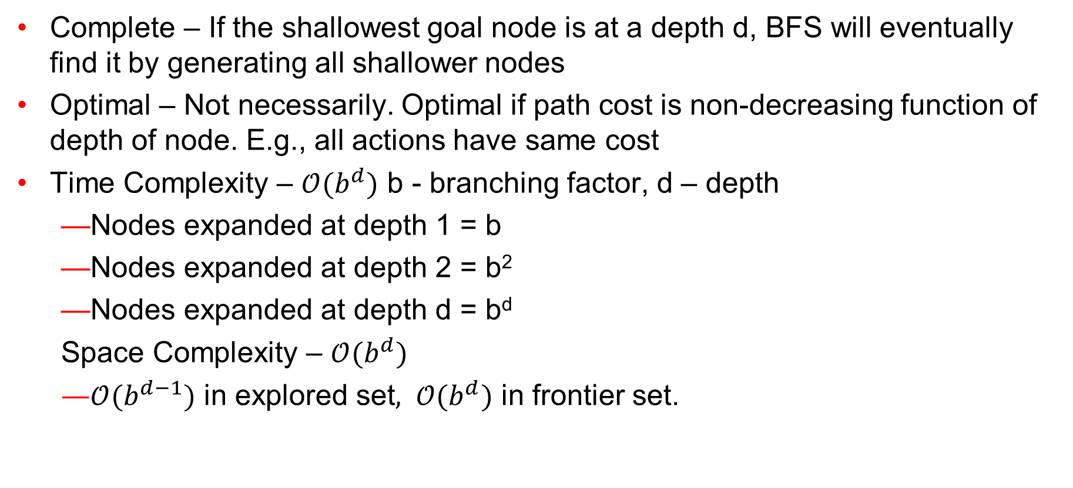
Breadth First Search – Evaluation
Complete – If the shallowest goal node is at a depth d, BFS will eventually find it by generating all shallower nodes
Optimal – Not necessarily. Optimal if path cost is non-decreasing function of depth of node. E.g., all actions have same cost
Time Complexity – $𝒪(b^{d})$ b - branching factor, d – depth
Nodes expanded at depth 1 = b
Nodes expanded at depth 2 = b²
Nodes expanded at depth d = b^{d}
Space Complexity – $𝒪(b^{d})$
$𝒪(b^{d−1})$ in explored set$, 𝒪(b^{d})$ in frontier set.

Slide 7
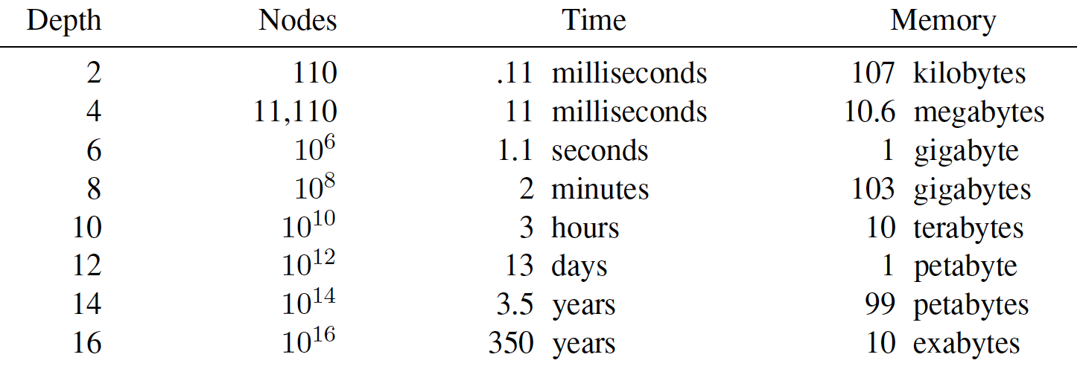
Breadth First Search – Evaluation
Why is Space Complexity a big problem? Imagine a problem with
branching factor b = 10
generates 1 million nodes/sec
Each node requires 1KB

Slide 8
Depth First Search

Slide 9
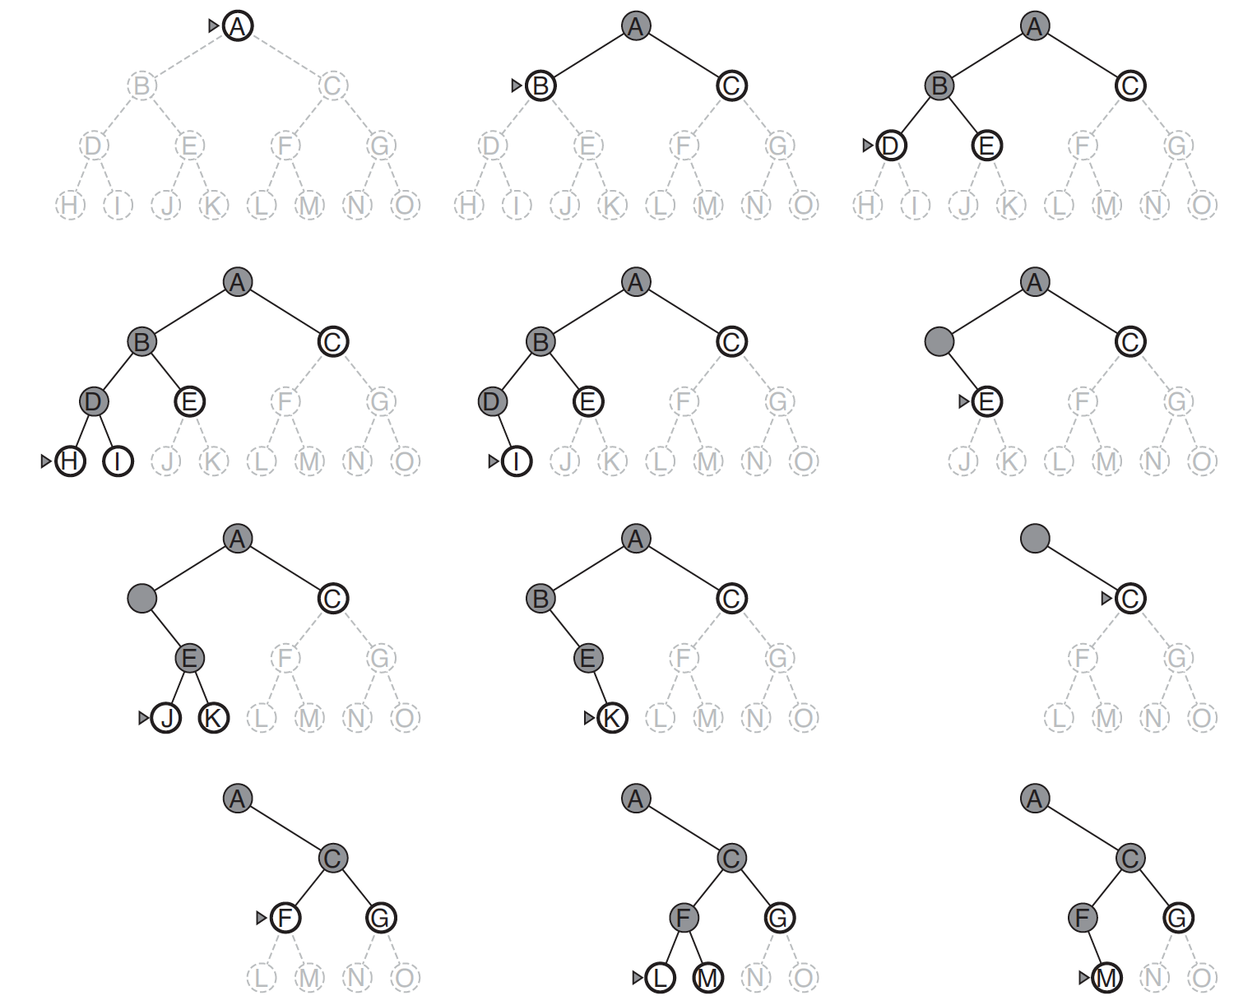
DFS

Slide 10
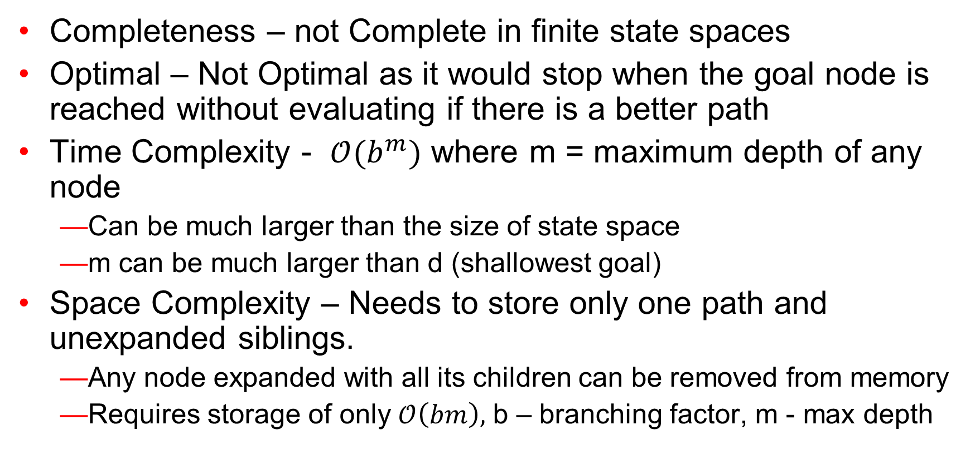
DFS - Evaluation
Completeness – not Complete in finite state spaces
Optimal – Not Optimal as it would stop when the goal node is reached without evaluating if there is a better path
Time Complexity - $𝒪(b^{m})$ where m = maximum depth of any node
Can be much larger than the size of state space
m can be much larger than d (shallowest goal)
Space Complexity – Needs to store only one path and unexpanded siblings.
Any node expanded with all its children can be removed from memory
Requires storage of only $𝒪\left(bm\right),$ b – branching factor, m - max depth

Slide 11
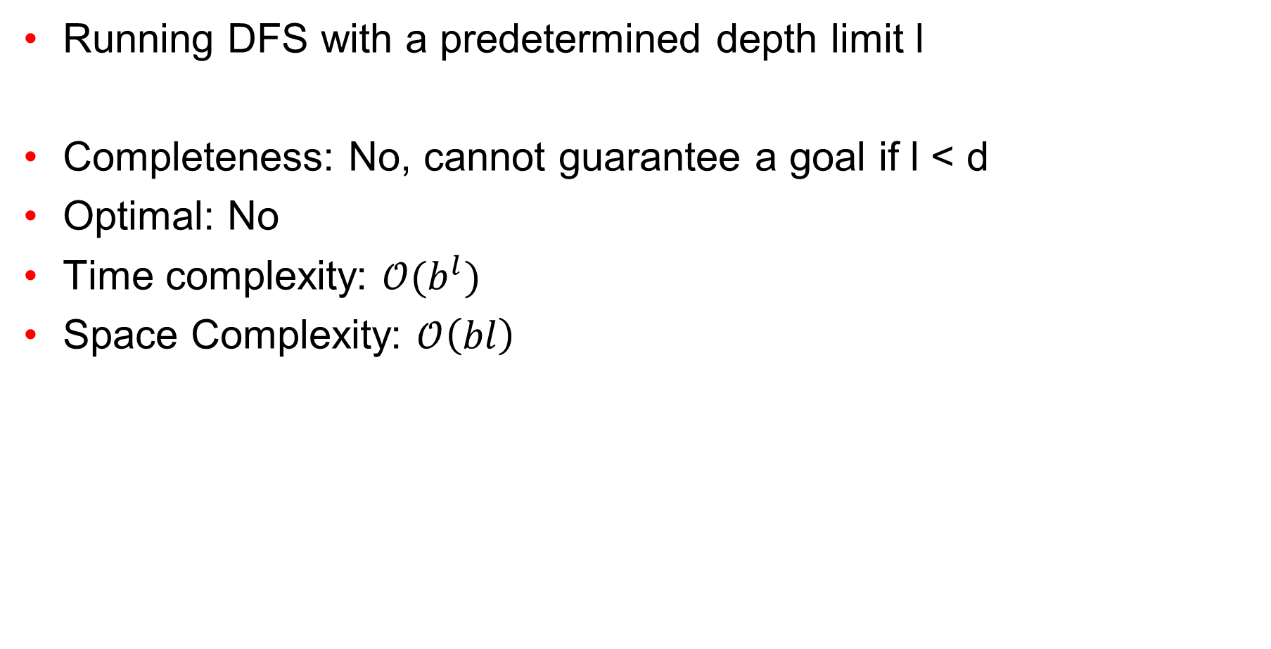
Depth Limited Search (DLS)
Running DFS with a predetermined depth limit l
Completeness: No, cannot guarantee a goal if l < d
Optimal: No
Time complexity: $𝒪(b^{l})$
Space Complexity: $𝒪\left(bl\right)$

Slide 12
Iterative Deepening Depth First Search (IDS

Slide 13
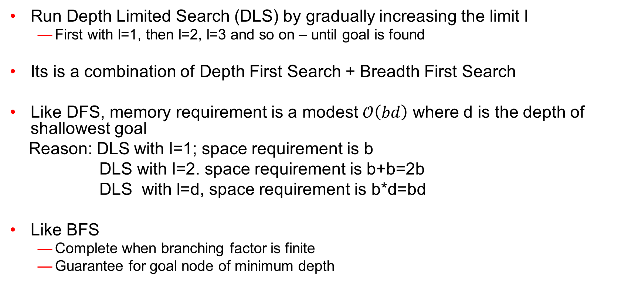
Iterative Deepening Depth First Search (IDS)
Run Depth Limited Search (DLS) by gradually increasing the limit l
First with l=1, then l=2, l=3 and so on – until goal is found
Its is a combination of Depth First Search + Breadth First Search
Like DFS, memory requirement is a modest $𝒪\left(bd\right)$ where d is the depth of shallowest goal
Reason: DLS with l=1; space requirement is b
DLS with l=2. space requirement is b+b=2b
DLS with l=d, space requirement is b*d=bd
Like BFS
Complete when branching factor is finite
Guarantee for goal node of minimum depth

Slide 14
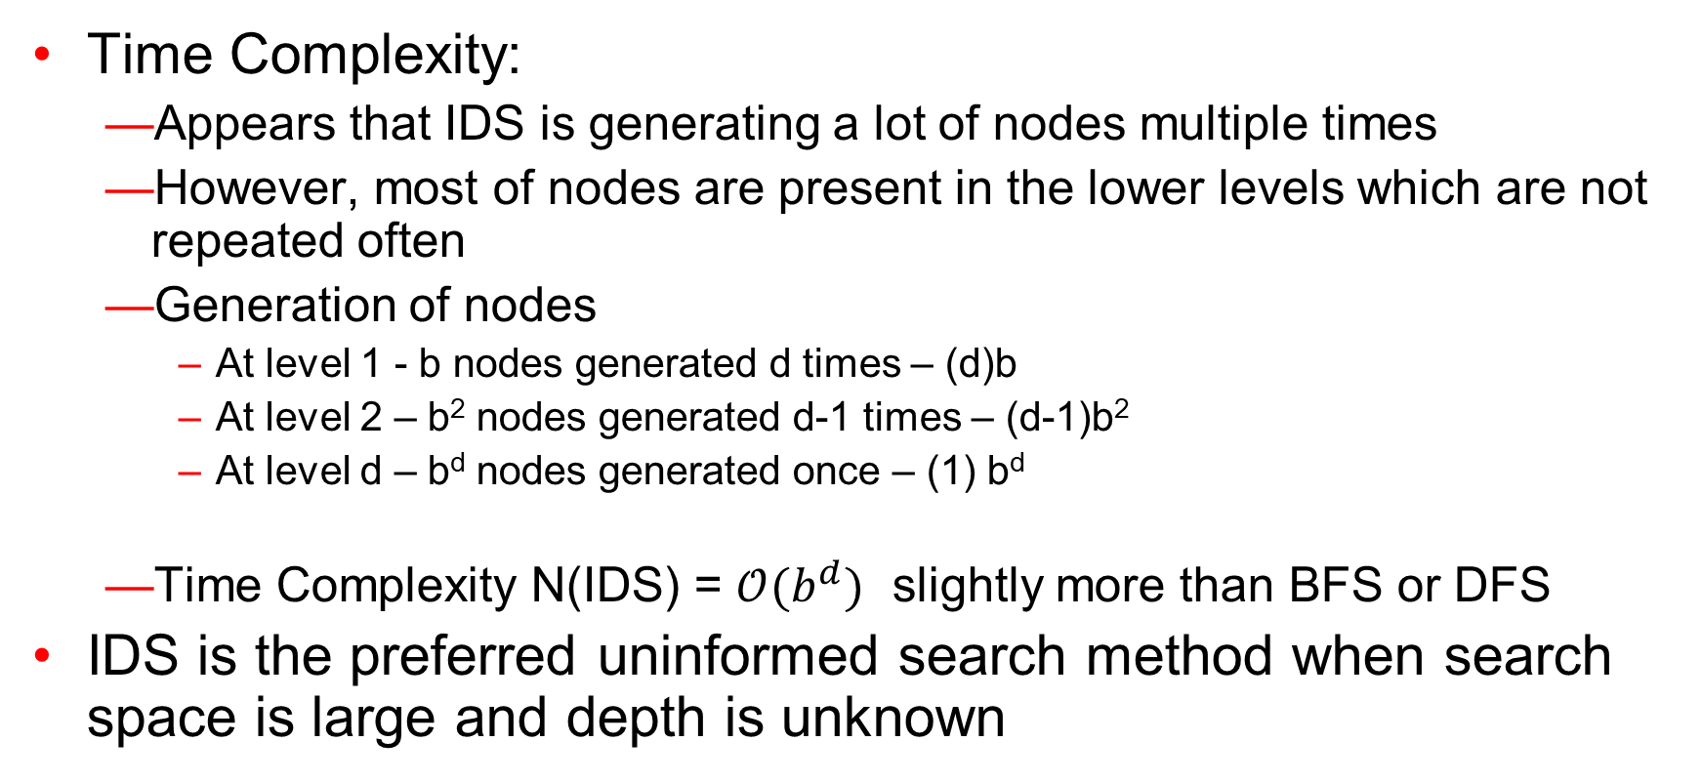
Iterative Deepening Depth First Search (IDS)
Time Complexity:
Appears that IDS is generating a lot of nodes multiple times
However, most of nodes are present in the lower levels which are not repeated often
Generation of nodes
At level 1 - b nodes generated d times – (d)b
At level 2 – b² nodes generated d-1 times – (d-1)b²
At level d – b^{d} nodes generated once – (1) b^{d}
Time Complexity N(IDS) = $𝒪(b^{d})$ slightly more than BFS or DFS
IDS is the preferred uninformed search method when search space is large and depth is unknown

Slide 15
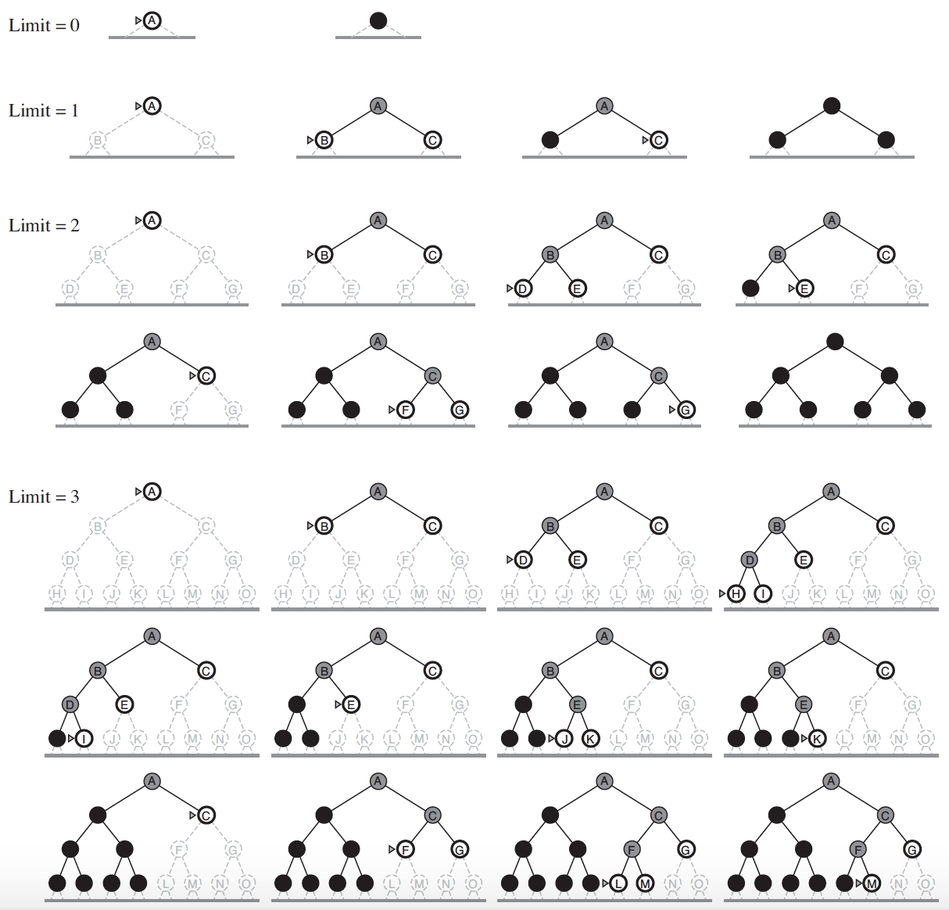
IDS

Slide 16
Bidirectional Search
Two different searches are run simultaneously
From start to goal
From goal to start
Usually BFS technique is used
Advantages:
Fast
Less memory
Disadvantage:
Implementation is difficult
The search stops when two graphs intersect each other

Slide 17
Example: Bidirectional Search

Slide 18
Uniform Cost Search
This algorithm is by Dijkstra [1959]. The algorithm expands nodes in the order of their cost from the source.
In uniform cost search the newly generated nodes are put in OPEN according to their path costs. This ensures that when a node is selected for expansion it is a node with the cheapest cost among the nodes in OPEN.
Let g(n) = cost of the path from the start node to the current node n. Sort nodes by increasing value of g.

Slide 19
Uniform Cost Search
Instead of expanding the shallowest node, Uniform-Cost search expands the node n with the lowest path cost g(n)
Sorting the Frontier as a priority queue ordered by g(n)
Goal test is applied during expansion
The goal node if generated may not be on the optimal path
Find a better path to a node on the Frontier

Slide 20
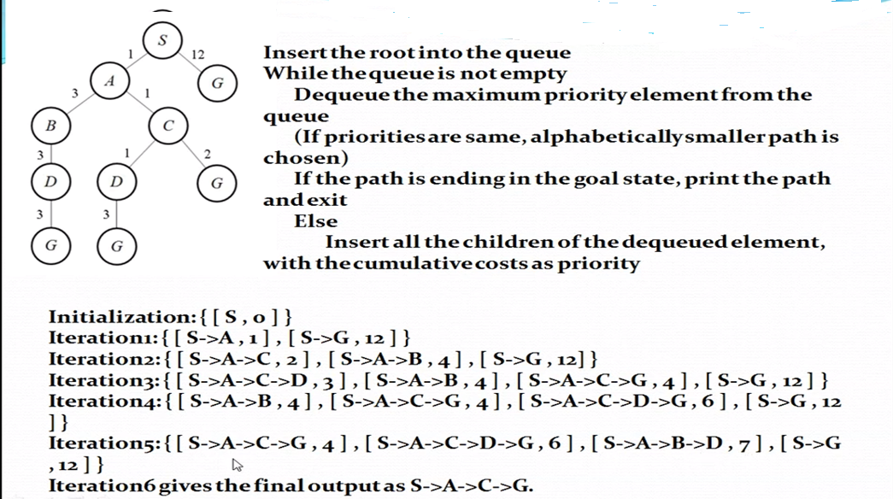
Uniform Cost Search

Slide 21
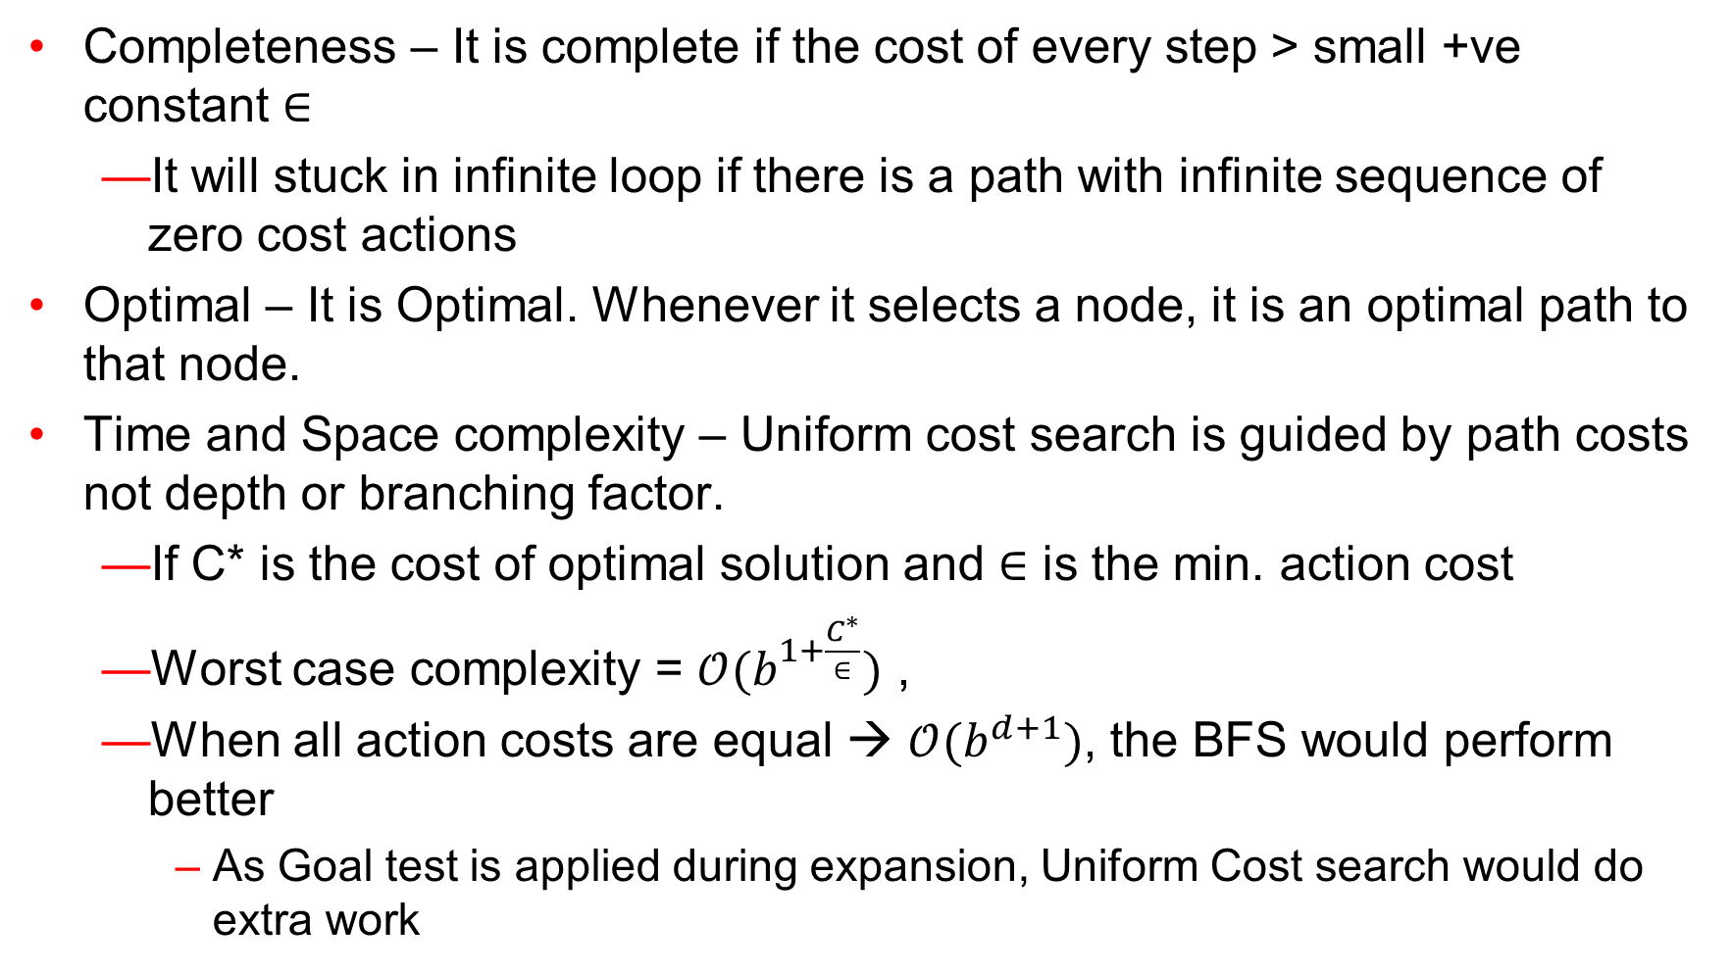
Uniform Cost Search – Evaluation
Completeness – It is complete if the cost of every step > small +ve constant $∈$
It will stuck in infinite loop if there is a path with infinite sequence of zero cost actions
Optimal – It is Optimal. Whenever it selects a node, it is an optimal path to that node.
Time and Space complexity – Uniform cost search is guided by path costs not depth or branching factor.
If C* is the cost of optimal solution and $∈$ is the min. action cost
Worst case complexity = $𝒪(b^{1+\frac{C^{∗}}{∈}})$ ,
When all action costs are equal → $𝒪(b^{d+1})$, the BFS would perform better
As Goal test is applied during expansion, Uniform Cost search would do extra work

Slide 22
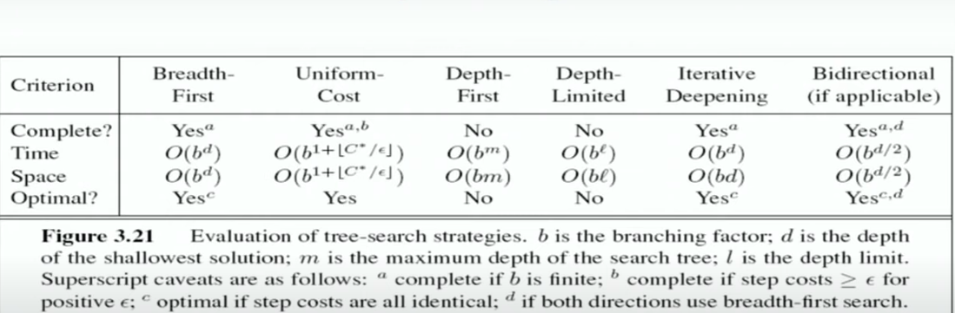
Summary

Slide 23
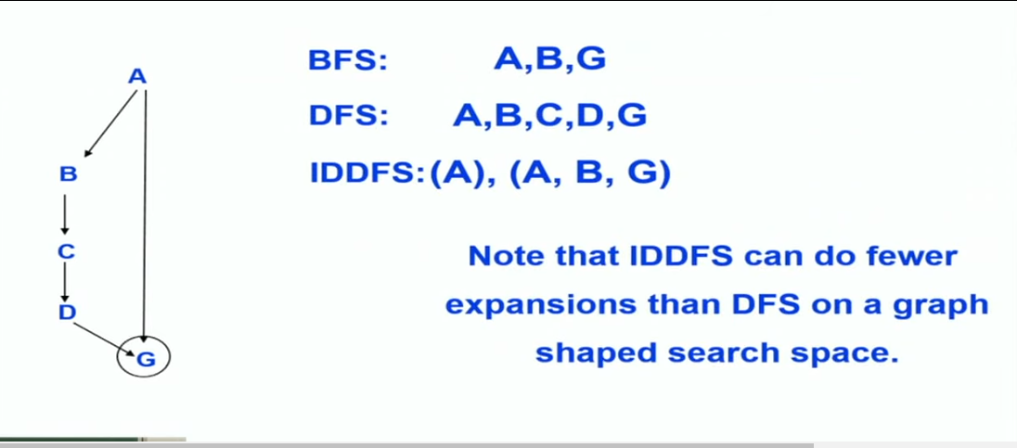
Comparison

Slide 24
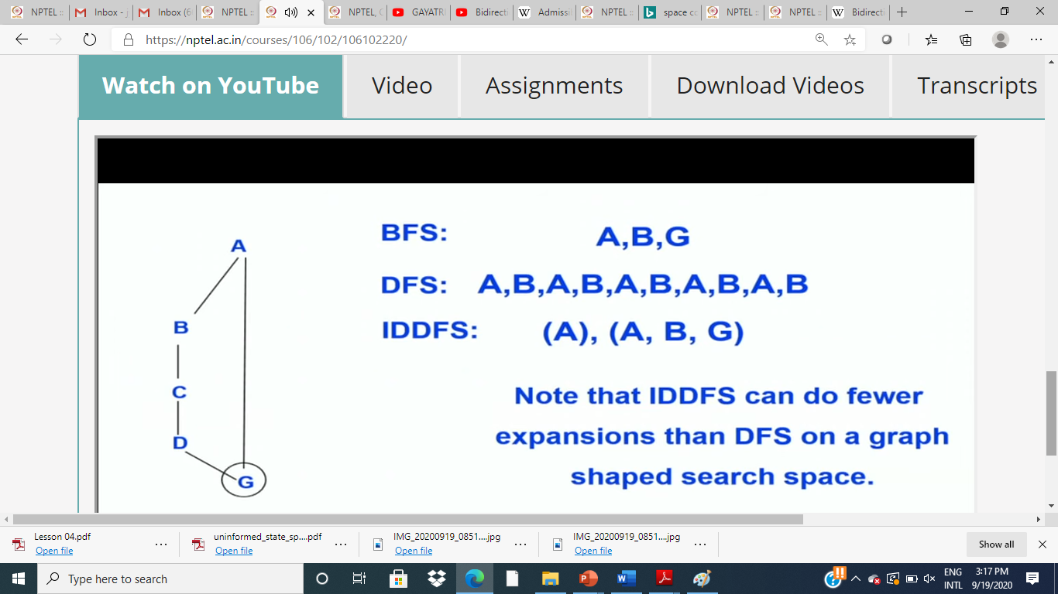
Search on undirected graph or directed graph with cycles

Slide 25
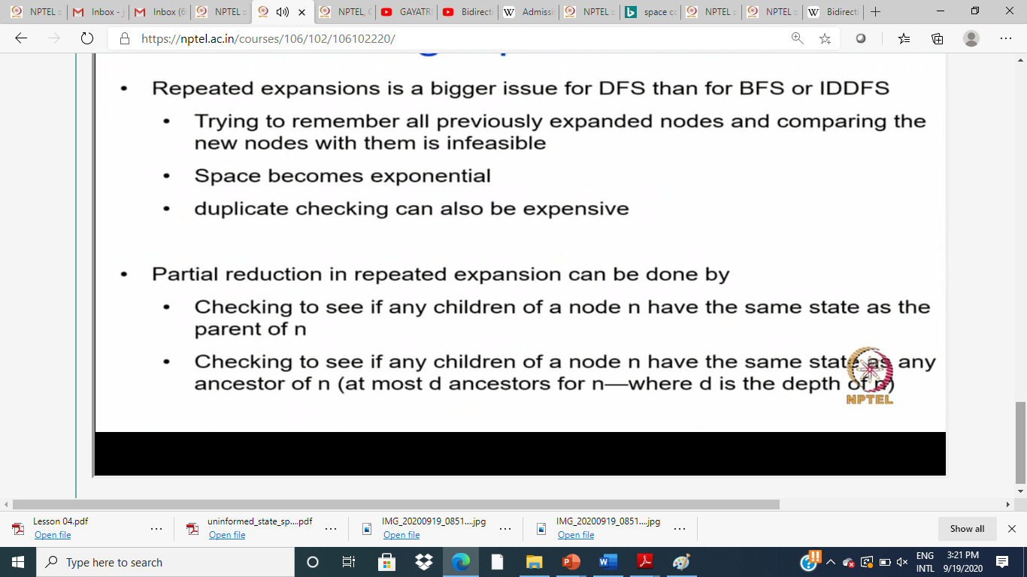
Graph Search: Handling repeated nodes

Slide 26
Disadvantage of Uninformed Search(Blind Search
Uninformed Search is slow
Solution: Add guidance (heuristic estimate)
Informed Search

Slide 27
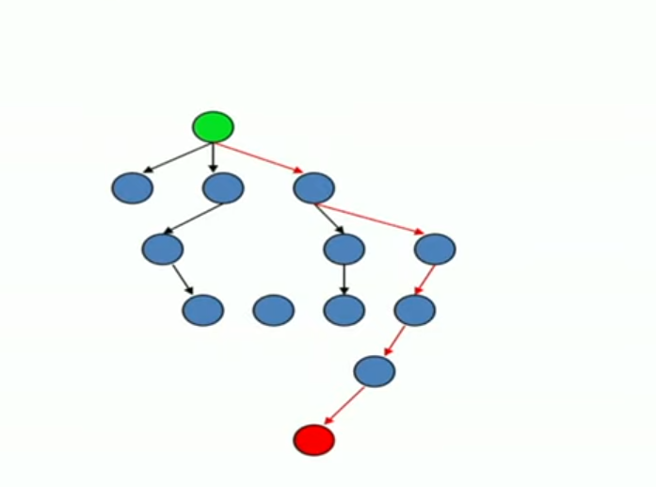
Informed Search
Idea: Be smart about what paths to try

Slide 28
Difference between Blind and informed Search
In uninformed search we only have problem at hand.
But in the informed search, node is selected for expansion based on an evaluation function that estimates cost to the goal.
Use problem specific knowledge beyond the definition of problem to
guide the search
Helps to cut the search space & thereby improves efficiency

Slide 29
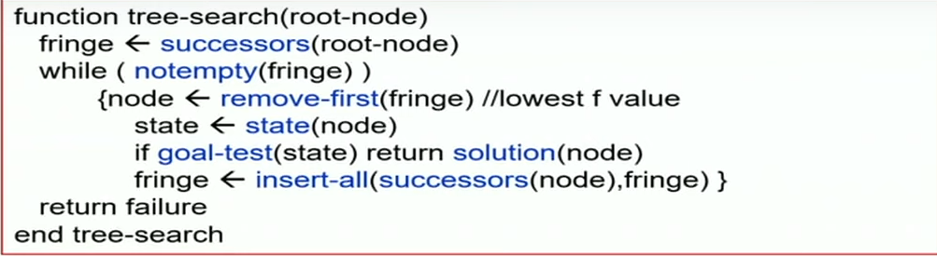
General Tree Search paradigm

Slide 30
Informed Search Algorithm
The evaluation function f(n) typically includes a heuristic function h(n)
h(n): Estimated cost of the cheapest path from the state at node n to a goal state
Used to include common form of additional knowledge to search algorithms
h(n) is non-negative
h(n) = 0 when n is goal node
brings in problem specific knowledge to solving search problem.

Slide 31
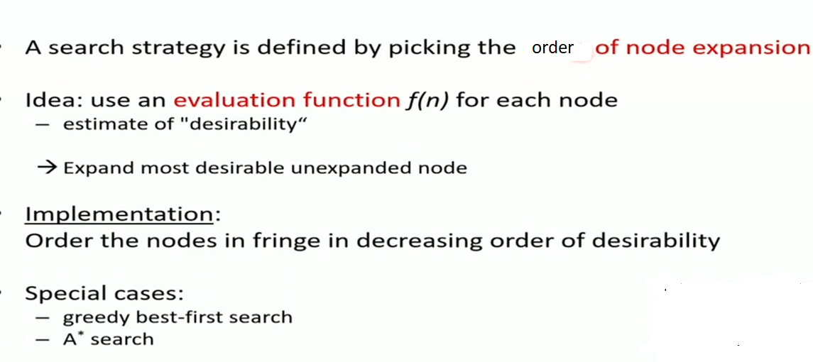
Best First Search f(n)=h(n)

Slide 32
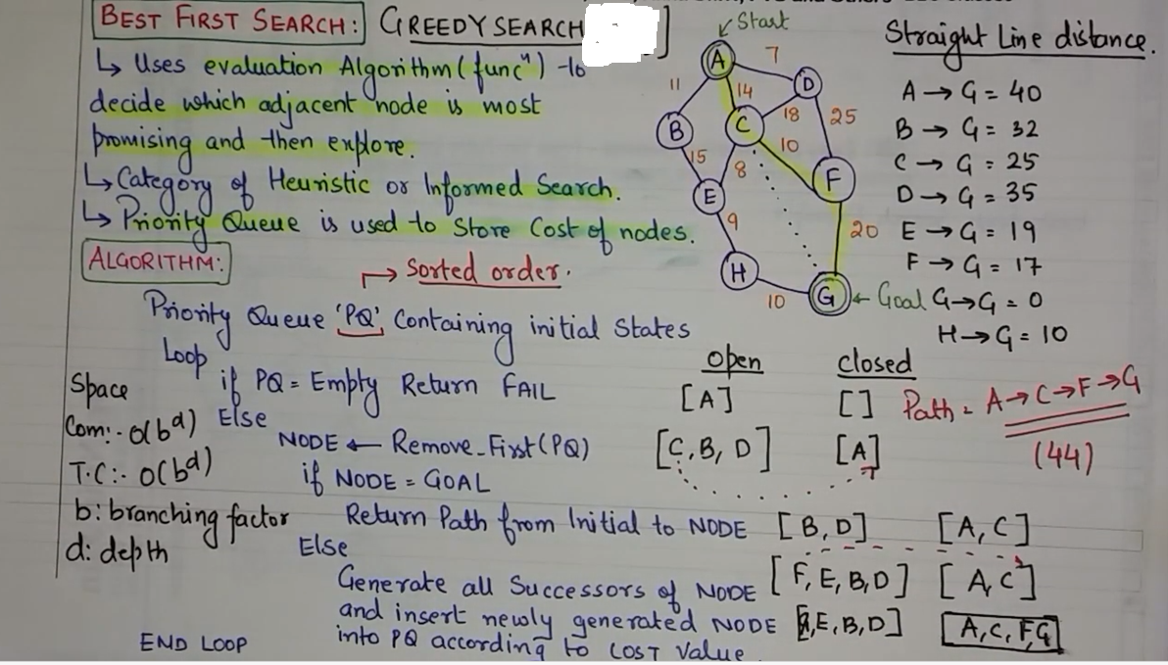
Example

Slide 33
